Slide 1

INSTITUTE : UIE
DEPARTMENT : CSE
Bachelor of Engineering (Computer Science & Engineering)
PROJECT BASED LEARNING IN JAVA
(20CST-319/20ITT-319)
TOPIC OF PRESENTATION:
Use of Collections in Java. ArrayList, LinkedList.
DISCOVER . LEARN . EMPOWER

Slide 2

Lecture Objectives
In this lecture, we will discuss:
Use of Collections in Java. ArrayList, LinkedList.

Slide 3
Collections in Java
Collections in java is a framework that provides an architecture to store and manipulate the group of objects.
All the operations that you perform on a data such as searching, sorting, insertion, manipulation, deletion etc. can be performed by Java Collections.
Java Collection simply means a single unit of objects. Java Collection framework provides many interfaces (Set, List, Queue, Deque etc.) and classes (ArrayList, Vector, LinkedList, PriorityQueue, HashSet, LinkedHashSet, TreeSet etc).

Slide 4
Collections in Java
What is Collection in java
Collection represents a single unit of objects i.e. a group.
What is framework in java
provides readymade architecture.
represents set of classes and interface.
is optional.
What is Collection framework
Collection framework represents a unified architecture for storing and manipulating group of objects. It has:
Interfaces and its implementations i.e. classes
Algorithm

Slide 5
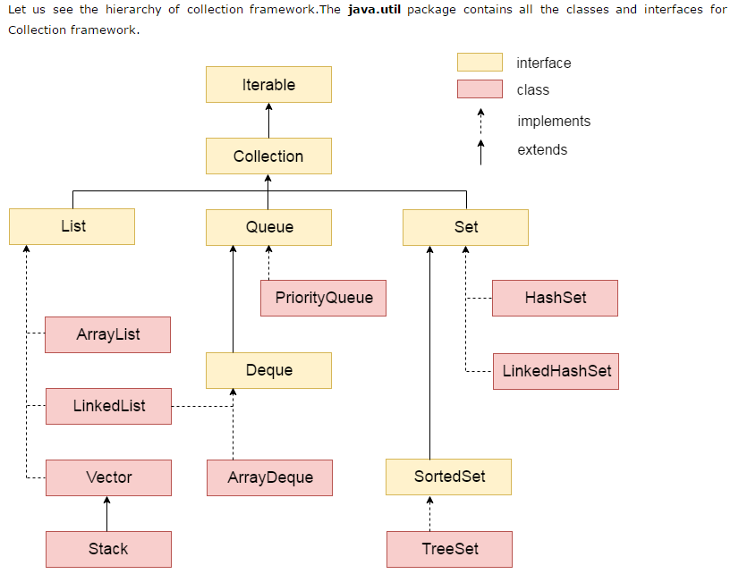

Slide 6
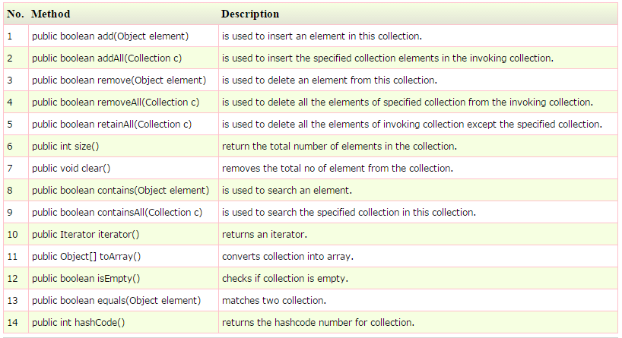
Methods of Collection interface
There are many methods declared in the Collection interface. They are as follows:

Slide 7
Iterator interface
Iterator interface provides the facility of iterating the elements in forward direction only. Methods of Iterator interface
There are only three methods in the Iterator interface. They are:
public boolean hasNext() it returns true if iterator has more elements.
public object next() it returns the element and moves the cursor pointer to the next element.
public void remove() it removes the last elements returned by the iterator. It is rarely used.

Slide 8
Java ArrayList class
Java ArrayList class uses a dynamic array for storing the elements. It inherits AbstractList class and implements List interface.
The important points about Java ArrayList class are:
Java ArrayList class can contain duplicate elements.
Java ArrayList class maintains insertion order.
Java ArrayList class is non synchronized.
Java ArrayList allows random access because array works at the index basis.
In Java ArrayList class, manipulation is slow because a lot of shifting needs to be occurred if any element is removed from the array list.

Slide 9
ArrayList
Array lists are dynamic in nature.Unlike arrays they are not of fixed size.
created with an initial size. When this size is exceeded, the collection is automatically enlarged. When objects are removed, the array may be shrunk.

Slide 10
Java ArrayList class
Hierarchy of ArrayList class
As shown in above diagram, Java ArrayList class extends AbstractList class which implements List interface. The List interface extends Collection and Iterable interfaces in hierarchical order.
ArrayList class declaration
Let's see the declaration for java.util.ArrayList class.
public class ArrayList<E> extends AbstractList<E> implements List<E>, RandomAccess, Cloneable, Serializable .

Slide 11
Constructors of Java ArrayList
ArrayList(): It is used to build an empty array list.
ArrayList(Collection c): It is used to build an array list that is initialized with the elements of the collection c.
ArrayList(int capacity): It is used to build an array list that has the specified initial capacity.

Slide 12
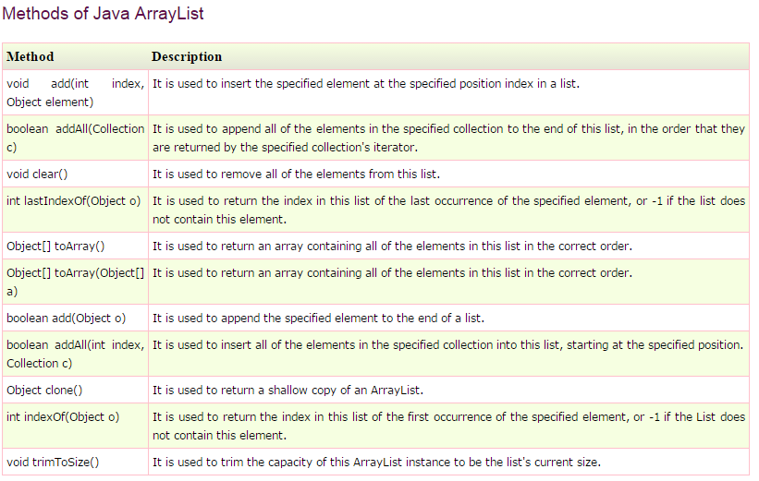

Slide 13
Java LinkedList class
Java LinkedList class uses doubly linked list to store the elements.
It provides a linked-list data structure.
It inherits the AbstractList class and implements List and Deque interfaces.
The important points about Java LinkedList are:
Java LinkedList class can contain duplicate elements.
Java LinkedList class maintains insertion order.
Java LinkedList class is non synchronized.
In Java LinkedList class, manipulation is fast because no shifting needs to be occurred.
Java LinkedList class can be used as list, stack or queue.

Slide 14
Hierarchy of LinkedList class
As shown in above diagram, Java LinkedList class extends AbstractSequentialList class and implements List and Deque interfaces.

Slide 15
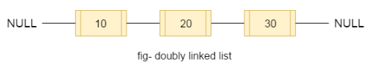
Doubly Linked List
In case of doubly linked list, we can add or remove elements from both side.
LinkedList class declaration
Let's see the declaration for java.util.LinkedList class.
public class LinkedList<E> extends AbstractSequentialList<E> implements List<E>, Deque<E>, Cloneable, Serializable

Slide 16
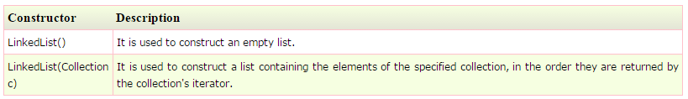
Constructors of Java LinkedList

Slide 17
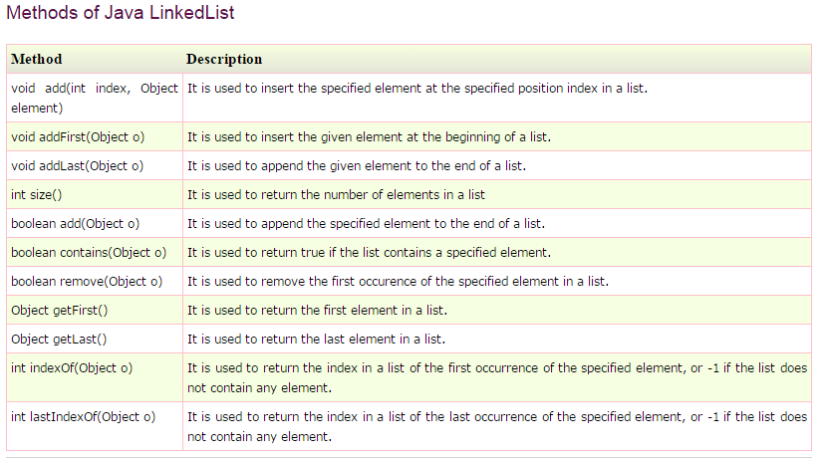

Slide 18
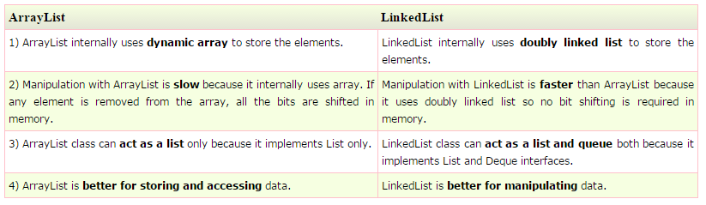
Difference between ArrayList and LinkedList

Slide 19
LinkedList
Sr.No. | Method & Description
1 | void add(int index, Object element)
 | Inserts the specified element at the specified position index in this list. Throws IndexOutOfBoundsException if the specified index is out of range (index < 0 || index > size()).
2 | boolean add(Object o)
 | Appends the specified element to the end of this list.
3 | boolean addAll(Collection c)
 | Appends all of the elements in the specified collection to the end of this list, in the order that they are returned by the specified collection's iterator. Throws NullPointerException if the specified collection is null.
4 | boolean addAll(int index, Collection c)
 | Inserts all of the elements in the specified collection into this list, starting at the specified position. Throws NullPointerException if the specified collection is null.
5 | void addFirst(Object o)
 | Inserts the given element at the beginning of this list.
6 | void addLast(Object o)
 | Appends the given element to the end of this list.
7 | void clear()
 | Removes all of the elements from this list.
8 | Object clone()
 | Returns a shallow copy of this LinkedList.
9 | boolean contains(Object o)
 | Returns true if this list contains the specified element. More formally, returns true if and only if this list contains at least one element e such that (o==null ? e==null : o.equals(e)).

Slide 20
LinkedList
10
 | Object get(int index)
 | Returns the element at the specified position in this list. Throws IndexOutOfBoundsException if the specified index is out of range (index < 0 || index >= size()).
11 | Object getFirst()
 | Returns the first element in this list. Throws NoSuchElementException if this list is empty.
12 | Object getLast()
 | Returns the last element in this list. Throws NoSuchElementException if this list is empty.
13 | int indexOf(Object o)
 | Returns the index in this list of the first occurrence of the specified element, or -1 if the list does not contain this element.
14 | int lastIndexOf(Object o)
 | Returns the index in this list of the last occurrence of the specified element, or -1 if the list does not contain this element.
15 | ListIterator listIterator(int index)
 | Returns a list-iterator of the elements in this list (in proper sequence), starting at the specified position in the list. Throws IndexOutOfBoundsException if the specified index is out of range (index < 0 || index >= size()).
16 | Object remove(int index)
 | Removes the element at the specified position in this list. Throws NoSuchElementException if this list is empty.

Slide 21
17 | boolean remove(Object o)
 | Removes the first occurrence of the specified element in this list. Throws NoSuchElementException if this list is empty. Throws IndexOutOfBoundsException if the specified index is out of range (index < 0 || index >= size()).
18 | Object removeFirst()
 | Removes and returns the first element from this list. Throws NoSuchElementException if this list is empty.
19 | Object removeLast()
 | Removes and returns the last element from this list. Throws NoSuchElementException if this list is empty.
20 | Object set(int index, Object element)
 | Replaces the element at the specified position in this list with the specified element. Throws IndexOutOfBoundsException if the specified index is out of range (index < 0 || index >= size()).
21 | int size()
 | Returns the number of elements in this list.
22 | Object[] toArray()
 | Returns an array containing all of the elements in this list in the correct order. Throws NullPointerException if the specified array is null.
23 | Object[] toArray(Object[] a)
 | Returns an array containing all of the elements in this list in the correct order; the runtime type of the returned array is that of the specified array

Slide 22
QUIZ:
Which of these standard collection classes implements a dynamic array?
AbstractList
LinkedList
ArrayList
AbstractSet
2. What implementation of Iterator can traverse a collection in both directions?
a.Iterator b.ListIterator c.SetIterator d.MapIterator

Slide 23
Summary:
In this session, you were able to :
• Use of Collections in Java. ArrayList, LinkedList

Slide 24
References:
Books:
1. Balaguruswamy, Java.
2. A Primer, E.Balaguruswamy, Programming with Java, Tata McGraw Hill Companies
3. John P. Flynt Thomson, Java Programming.
Video Lectures :
https://youtu.be/VvDTro4Shzg
Reference Links:
https://www.javatpoint.com/collections-in-java
https://www.geeksforgeeks.org/collections-in-java-2/
https://beginnersbook.com/java-collections-tutorials/
https://www.tutorialspoint.com/java/java_collections.htm
https://docs.oracle.com/javase/7/docs/api/java/util/Collection.html
https://docs.oracle.com/javase/8/docs/technotes/guides/collections/overview.html
https://www.edureka.co/blog/java-collections/

Slide 25
THANK YOU

